Slide 1
CONVERSIONS DIGITAL to ANALOG SIGNALS D/A

Slide 2
Introduction
To interface the digital and analog world, we need converters that can convert analog to digital (ADC) and vice-versa (DAC).
Analog Signals:
Physical quantities are “continuous” infinite number of quantities over a given range of values.
Examples: temperature, pressure, time, velocity, acceleration, fluid flow, etc
Digital Signals:
Digital signals are those with discrete values and are represented by binary codes.
Examples: digital audio, computer system signals, electronic music systems.
Notes:
2

Slide 3
Interfacing
Interfacing is a process of making 2 or more devices or systems operationally compatible with each other so that they function together as required
. . . Interfacing Analog and Digital Worlds . . .
converting digital codes to analog quantities and vice versa
Analog-to-digital conversion (ADC)
Analog World
Continuous values in a given range
Interface
Circuit
Digital World
Discrete set of values
Digital-to-analog conversion (DAC)
Notes:
3

Slide 4
Real World Interfacing
Examples:
Electronic thermostat,
CD player,
Digital Audio Tape (DAT) Player/Recorder
Digital reproduction of the analog curve
Sample discrete points in an analog curve
10010
10001
DAC
10000
01110
01101
ADC
01100
01001
00101
00100
00011
00000
Notes:
4

Slide 5
Types of DACs
Many types of DACs available.
Usually switches, resistors, and op-amps used to implement conversion
Two Types:
Binary Weighted Resistor
R-2R Ladder

Slide 6
Digital-to-Analog (D/A) Conversion
D/A conversion is the process of taking a value represented in digital code and converting it to a voltage or current that is proportional to the digital value
For each digital input code, the output is a unique analog value
Analog Output, V_{out} = digital input x k
D
Example: If k=0.5, and DCBA=1011,
what is the value of V_{out} ?
4-bit
D/A Converter
(DAC)
Digital Inputs
C
V_{out}
B
A
Analog Output = 11 x 0.5 = 5.5V
Notes:
6

Slide 7
Resolution & Full Scale Voltage
Resolution or step size of a DAC is the smallest change that can occur in the analog output as a result of a step change in the digital input (LSB weightage)
Analog output = digital input x k,
k = analog output/digital input, (resolution or step size)
Full scale output is the DAC output when digital input is at maximum value,
E.g. a 4-bit DAC FS output = 1111₂k = 15k = 15 x step size
For n-bit DAC, full scale output = (2^{n} – 1)k
Example: If step size, k of a 10-bit DAC is 0.05V, the full scale output voltage is ______________
1023 x 0.05 = 51.15V
Notes:
7

Slide 8
Full Scale Voltage
Full-scale voltage is the output voltage of DAC when maximum value of the digital inputs are applied.
Refer to figure below, the full scale voltage (when input is 111) is 7V. Step size or resolution is _______
1 V
7V (full scale voltage)
3-bit counter
C
B
A
0
0
0
0
0
1
0
1
0
1
1
1
3-bit DAC
F S output = 7V
V_{out}
1V
0V
Resolution =
= 1 V
clock
1
x
7
Volts
t_{c}
2
3
−
1
t_{c}
Another example: What is the step size for a 4-bit DAC operating with a full scale voltage of 8V? _________
8 ÷ 15 = 0.53 V
Notes:
8

Slide 9
Percentage Resolution
Although resolution can be expressed as the amount of output voltage per step, it is useful to express it as a percentage of the full scale output
% resolution = (step size)/(full scale value) x 100%
= k/(2^{n} – 1)k x 100%
=
E.g. % Resolution of a 10-bit DAC is (1/1023)x100%
= 0.098%
Will % resolution change if the full scale voltage is changed? ___________________________
1
x 100%
x 100%
2^{n} – 1
NO, it only depends on the DAC number of bits
Notes:
9

Slide 10
DAC Circuitry
There are several methods and circuits for producing the DAC.
However it is not necessary to familiar with all the various circuit schemes because DAC ICs are available, which do not require any circuit knowledge
Instead it is important to know the significant performance characteristics for intelligent use of the DAC IC
Notes:
10

Slide 11
4-bit DAC with Binary Weighted Inputs
Example
Virtual ground
R_{f}
+5V
V₀
R₀
(LSB)
1
D₀
I₀
I_{f}
0 V
+Vs
V₁
R₁
0
D₁
Digital input
D₃D₂D₁D₀
I₁
–
0 V
?
V₂
R₂
0
D₂
I_{sum}
I₂
I = 0
V_{out}
₁ ₀ ₀ ₁
+5V
V₃
R₃
1
D₃
+
0 - V_{out} = I_{f} x R_{f}
(MSB)
I₃
-Vs
V_{out} = - I_{f} x R_{f}
For each input data bit,
V_{n} = V_{HI} (usually +5V) when digital data input D_{n} = 1
V_{n} = 0 V for D_{n} = 0, where n = 0 to 3
That is, V_{n} = V_{HI} (5V) or 0V , when D_{n} = 1 or 0 respectively
I_{f} = I_{sum} = I₃ + I₂ + I₁ + I₀
where I₃ = V₃/R₃, I₂ = V₂/R₂, I₁ = V₁/R₁, I₀ = V₀/R₀
Notes:
11

Slide 12
4-bit DAC with Binary Weighted Inputs
In DAC, for every input bit, the voltage is assumed as 0V (if bit is logic 0) and +5V (if bit is logic 1).
Example: if bit D₀ = 0, then the voltage V₀ = 0V
if bit D₀ = 1, then the voltage V₀ = +5V
Thus voltage at input is either 0V or +5V.
The input resistors R₀ to R₃ contribute the binary weightages. The current or voltage contribution from the LSB branch, I₀ is the least and MSB branch, I₃ is the most. To achieve this,
R₀ = 2R₁, R₁ = 2R₂, R₂ = 2R₃
(R_{LSB} has largest value while R_{MSB} has least value)
Notes:
12

Slide 13
4-bit DAC with Binary Weighted Inputs
The operational amplifier is the summing amplifier and produces an output that is the weighted sum of the input voltages.
I_{sum} is the summation of all the currents in the resistors flowing through the feedback resistor R_{f}.
V_{out} = - I_{sum} R_{f} = - (I₃ + I₂ + I₁ + I₀) R_{f}
=
V₃
R₃
V₂
R₂
V₁
R₁
V₀
R₀
- R_{f} (
+
+
+
)
Notes:
13

Slide 14
4-bit DAC with Binary Weighted Inputs
V_{out} = - I_{sum} R_{f} = - (I₃ + I₂ + I₁ + I₀) R_{f}
V_{out} =
where V₃, V₂, V₁, V₀ is logic 0 (0V) or logic 1 (5V) for TTL
For binary weighted currents to flow into R₀, R₁, R₂, R₃,
R₀ = LSB resistor, R₁= , R₂= , R₃=
Therefore, V_{out} =
V₃
R₃
V₂
R₂
V₁
R₁
V₀
R₀
- R_{f} (
+
+
+
)
R₀
2
R₀
4
R₀
8
8V₃
R₀
4V₂
R₀
2V₁
R₀
1V₀
R₀
- R_{f} (
+
+
+
)
Notes:
14

Slide 15
4-bit DAC with Binary Weighted Inputs
V_{out} =
=
Step-size is found by setting data input to 0001₂
V_{step-size} =
Percentage resolution =
8V₃
R₀
4V₂
R₀
2V₁
R₀
V₀
R₀
- R_{f} (
+
+
+
)
R_{f}
R₀
(8V₃ + 4V₂ + 2V₁ + V₀)
where V_{n} is 0 or 5 volts
5R_{f}
R_{LSB}
1
(2^{n} – 1)
X 100%
Notes:
15

Slide 16
Full Scale Voltage
Method 1: V_{out} =
Where V₃ = V₂ = V₁ = V₀ = 5V
Method 2:
For full scale output set input D₃D₂D₁D₀= 1111₂ (15₁₀)
V_{FS} = =
= step size x maximum digital input value
= step size x (2^{n} – 1) where n = no of bits
V₃
R₃
V₂
R₂
V₁
R₁
V₀
R₀
- R_{f} (
+
+
+
)
5R_{f}
R₀
5R_{f}
R₀
(1111₂)
15
Notes:
16

Slide 17
Example 1
A 5-bit binary weighted DAC is given in the next slide. Assuming the input voltage at each bit is either 0V or +5V for logic 0 and 1 respectively, calculate
Step size or resolution
Full scale output voltage, V_{out}
V_{out} for binary code of 11010
Binary input for V_{out} = - 0.75V
Given that R_{f} = 10 KΩ, R₄ (MSB) = 25 KΩ
Notes:
17

Slide 18
Example 1
LSB
R_{f}
D₀
V₀
R₀
V₁
R₁
+Vs
D₁
V₂
R₂
–
D₂
V_{out}
D₃
V₃
R₃
+
D₄
V₄
R₄
-Vs
MSB
Remember:
R₀ is resistor for LSB and has the largest value
Notes:
18

Slide 19
Example 1
Step size
Step size =
R₀ = 400 kΩ (R₀ is LSB resistor)
step size = - 5 R_{f} / R₀ = - 5x10/400 V = - 0.125V
5R_{f}
R₀
R₃ =
50kΩ,
R₂ = 100kΩ,
R₁ = 200kΩ
Full Scale Output voltage
Data = 11111 for V_{out(FS)}
V_{out(FS)} = (2⁵ – 1) x step size = - 31 x 0.125V = - 3.875V
For data input = 11010,
V_{out} = 11010₂ x step size = - 26 x 0.125V = - 3.25V
Binary input = V_{out}/step-size = (-0.75)/(-0.125) = 6₁₀ = 00110₂
Notes:
19

Slide 20
Example 2
The analog output of a 5-bit DAC as shown below is connected to a Light Emitting Diode (LED) circuit through an inverting unity gain buffer, so that its voltage is used to light up the LED.
R_{A}
R_{f}
A
R_{B}
B
R_{C}
–
C
Inverting
Buffer
LED
Circuit
R_{D}
V_{out}
D
+
R_{E}
E
Notes:
20

Slide 21
Example 2 (con’t)
Given that R_{A} is the LSB resistor (least weighted resistor) of the DAC having a value of 800 kΩ, write down the resistance values of all the DAC input resistors R_{B}, R_{C}, R_{D}, and R_{E.}
Given that the magnitude of the full scale output of the DAC V_{out} is -3.875V, calculate the value of the feedback resistor R_{f}. Assume that a logic “1” at the inputs of the DAC is +5V and a logic “0” is 0V.
If the LED requires at least V_{out}=-1.5V to turn ON and that it can withstand a forward voltage of -15V, determine the range of input binary codes to the DAC that are able to turn ON the LED.
Notes:
21

Slide 22
Example 2 Solution
The LSB resistor, R_{A} has the highest value (smallest input current contribution to summing amplifier).
R_{B} = R_{A}/2 = 800k/2 = 400 kΩ
R_{C} = R_{B}/2 or R_{A}/4 = 200 kΩ
R_{D} = R_{C}/2 or R_{A}/8 = 100 kΩ
R_{E} = R_{D}/2 or R_{A}/16 = 50 kΩ
Notes:
22

Slide 23
Example 2 Solution
Full scale voltage = - 3.875V
Step size = - 3.875/(2⁵-1) = - 0.125V
Step size = - 5R_{f} /R_{A} = -0.125
Therefore R_{f} = (0.125 x 800)/5 kΩ = 20kΩ
For V_{out} = -1.5V, binary input = -1.5/step-size
= 1.5/0.125 = 12 (or 01100₂)
-15V exceeds the full scale output of -3.875V
Input codes to turn LED on are from 12 to 31
or 01100₂ to 11111₂
Notes:
23

Slide 24
Binary Weighted Resistor
Advantages
Simple Construction/Analysis
Fast Conversion
Disadvantages
Requires large range of resistors (2000:1 for 12-bit DAC) with necessary high precision for low resistors
Requires low switch resistances in transistors
Can be expensive. Therefore, usually limited to 8-bit resolution.

Slide 25
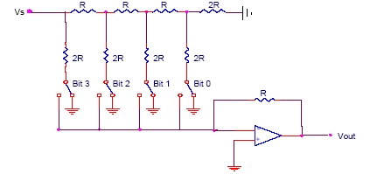
R-2R Ladder
Each bit corresponds
to a switch:
If the bit is high,
the corresponding
switch is connected to
the inverting input of
the op-amp.
If the bit is low, the
corresponding switch
is connected to ground.
V_{ref}
Bit: 0 0 0 0
V_{out}
4-Bit Converter

Slide 26
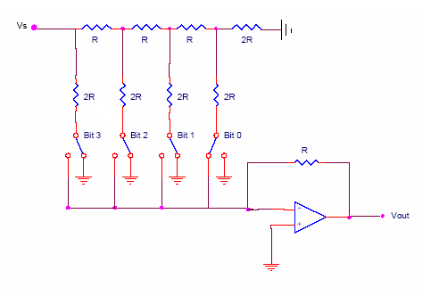
R-2R Ladder
V₃
V_{ref}
V₁
V₂
V₃
Ideal Op-amp
2R
2R

Slide 27
R-2R Ladder
V_{ref}
V₁
V₂
V₃
V₂
V₃
R
R
I
Likewise,
V_{out}

Slide 28
R-2R Ladder
Results:
V_{ref}
V₁
V₂
V₃
Where b₃ corresponds to bit 3,
b₂ to bit 2, etc.
If bit n is set, b_{n}=1
If bit n is clear, b_{n}=0
V_{out}

Slide 29
R-2R Ladder
For a 4-Bit R-2R Ladder
For general n-Bit R-2R Ladder or Binary Weighted Resister DAC

Slide 30
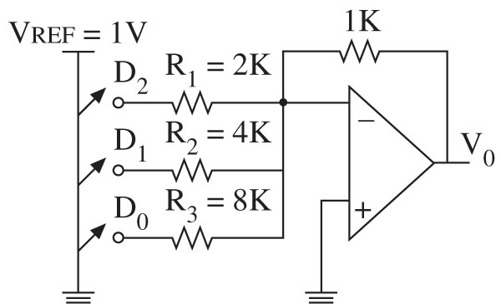
Problem
If the reference voltage is 1 V, and if all switches are connected, the output current can be calculated as follows:
Output voltage

Slide 31
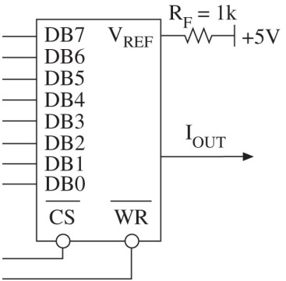


Problem
Vref = 5V
What will be the analog equivalent of 1001 0001?

Slide 32
R-2R Ladder
Advantages
Only two resistor values (R and 2R)
Does not require high precision resistors
Disadvantage
Lower conversion speed than binary weighted DAC

